Slide 1
Engineering Economy
Chapter 1: Introduction to Engineering Economy

Slide 2
The purpose of this book is to develop and illustrate the principles and methodology required to answer the basic economic question of any design: Do its benefits exceed its cost?

Slide 3
Engineering economy…
involves the systematic evaluation of the economic merits of proposed solutions to engineering problems.

Slide 4
Solutions to engineering problems must
promote the well-being and survival of an organization,
embody creative and innovative technology and ideas,
permit identification and scrutiny of their estimated outcomes, and
translate profitability to the “bottom line” through a valid and acceptable measure of merit.

Slide 5
Engineering economic analysis can play a role in many types of situations.
Choosing the best design for a high-efficiency gas furnace.
Selecting the most suitable robot for a welding operation on an automotive assembly line.
Making a recommendation about whether jet airplanes for an overnight delivery service should be purchased or leased.
Determining the optimal staffing plan for a computer help desk.

Slide 6
There are seven fundamental principles of engineering economy.
Develop the alternatives
Focus on the differences
Use a consistent viewpoint
Use a common unit of measure
Consider all relevant criteria
Make uncertainty explicit
Revisit your decisions

Slide 7
Engineering economic analysis procedure
Problem definition
Development of alternatives
Development of prospective outcomes
Selection of a decision criterion
Analysis and comparison of alternatives.
Selection of the preferred alternative.
Performance monitoring and postevaluation of results.

Slide 8
Electronic spreadsheets are a powerful addition to the analysis arsenal.
Most engineering economy problems can be formulated and solved using a spreadsheet.
Large problems can be quickly solved.
Proper formulation allows key parameters to be changed.
Graphical output is easily generated.

Slide 9
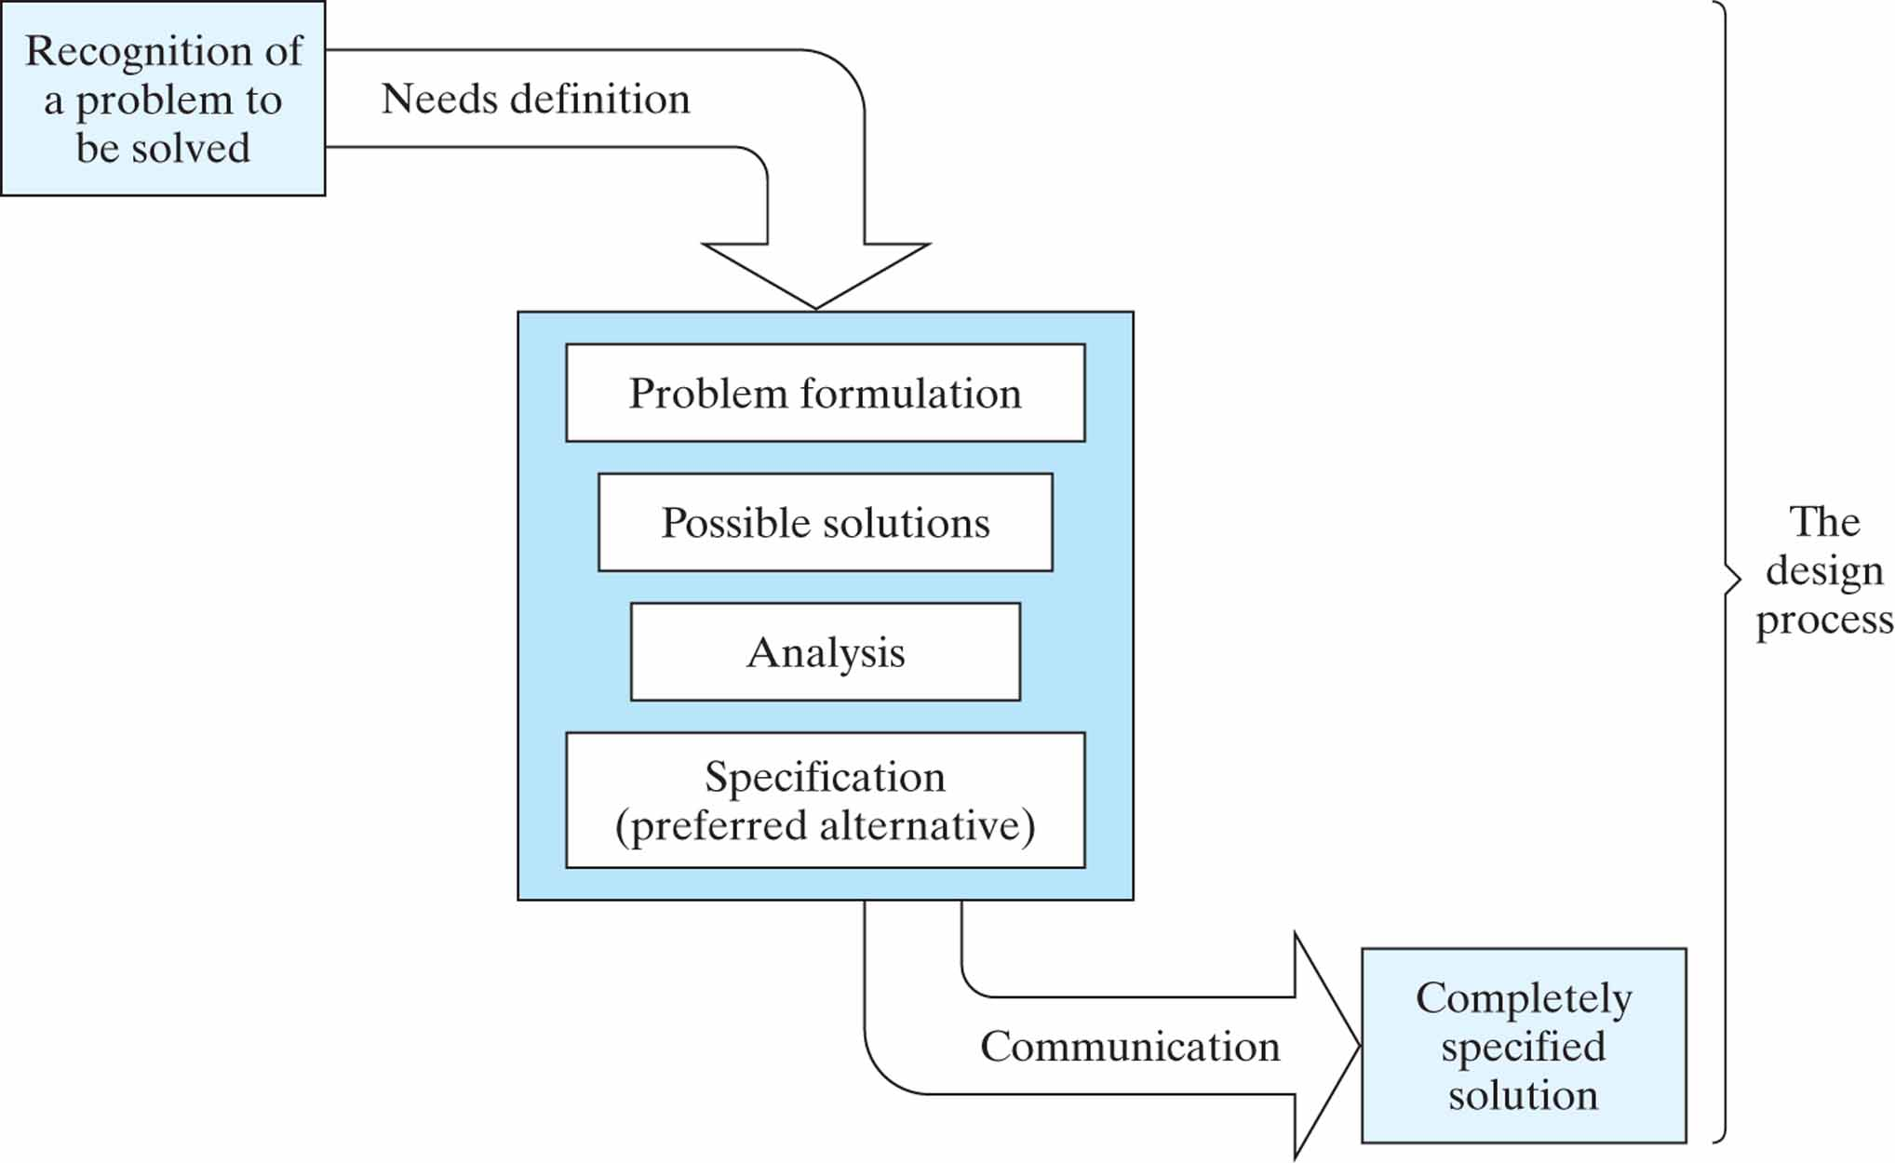
Figure P1-15

